Slide 1


O2 Home Phone
Presentation to Affiliate Partners 24.05.2010

Slide 2










O2 Home Broadband – the story so far
We launched in late 2007 with Home Broadband packages that offered great quality at low prices…
Key differentiators from the competition
Unlimited downloads
Free, UK-based Customer Services
No connection fees
30 day Happiness Guarantee
Awards, awards and more awards!
Strong underlying fandom and market-leading CSI
Fans %
CSI: 79

Slide 3
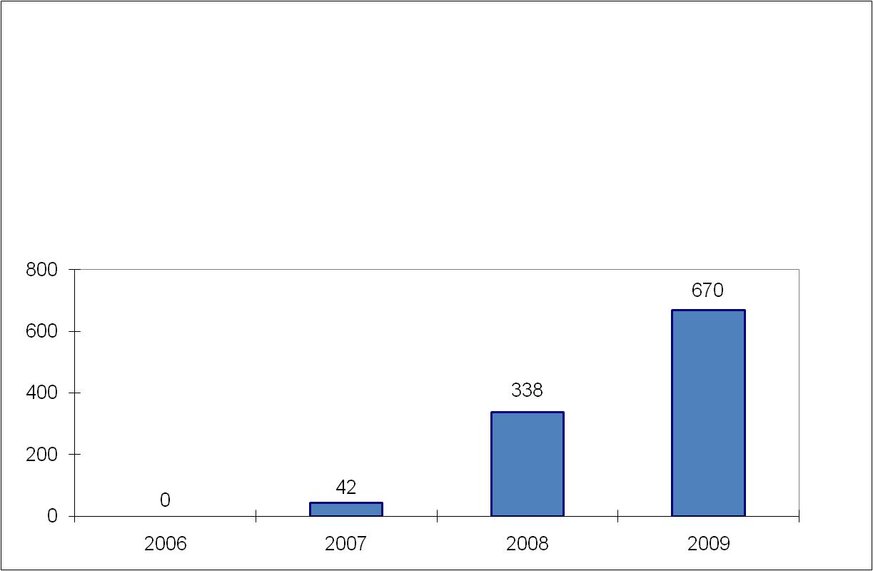
…which have helped us grow from nowhere to a major share of the Net market in little over 2 years
O2 Broadband Customer Growth
Share of Net connections - 2009
2009 base growth
23%
8%
74%
4%
-3%
-16%
5%
O2/Be Cumulative Net Connections

Slide 4

Where is O2 heading?
Today
2011 and beyond
Leading mobile company
Leading connectivity
service brand
Mobiles
The connecting company
Care about our customers
Love our customers
Turning customers into fans
Twice as many fans as
our nearest competitor
O2 Home Broadband was the first step on the journey towards becoming the leading connectivity service brand and winning more fans.
O2 Home Phone is the next.
Notes:
4

Slide 5
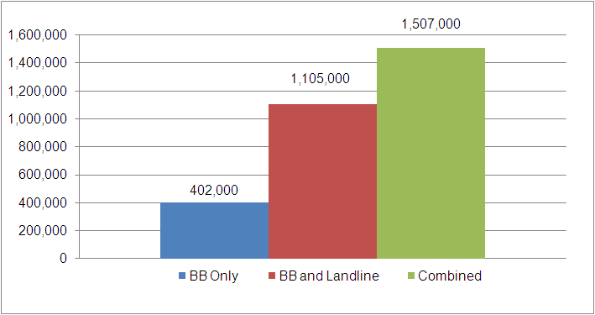
Adding Home Phone more than doubles our addressable market…
Total Market Gross Connections - 2010
274% increase
For 2010, customers in the market seeking a home phone and broadband bundle are estimated at over 1.1 million, compared to only 403k seeking broadband only.

Slide 6


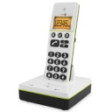
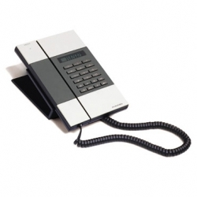

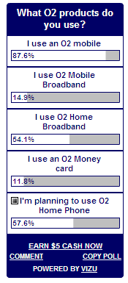
…it’s what our existing customers and new prospects want…
67% of people prefer to bundle their home broadband with a home phone solution
Bundles including home phone and broadband remain the most popular making up 75% of bundled sales
The vast majority of leavers opt for a package with their new provider that includes landline
55% of leavers would have remained a customer if offered a package including landline
58% of customers polled on the o2.co.uk blog said that they would use O2 Home Phone

Slide 7

…so O2 Home Phone is here
Evening & Weekend - £9.50/month:
Line rental
Unlimited evening and weekend calls to UK landlines starting with 01, 02, and 03
Anytime - £12.50/month:
Line rental
Unlimited anytime calls to UK landlines starting with 01, 02, and 03
600 minutes of calls to 0845 and 0870 numbers
600 minutes of calls to landlines in over 20 international destinations
25% discount on calls to mobiles from your landline

Slide 8
Key differentiators:
Value – the cheapest Evening and Weekend package of any major provider in the market at £9.50
Convenience – customers can now combine their O2 Home Broadband and Home Phone costs in one bill
Flexibility – a variety of key Bolt-Ons that can be added to your service if you choose, or left off if you want to keep your package cheap
Online bills only - no paper billing
Customers can keep their original home phone number
Award-winning, free, UK-based Customer Service
30 day Happiness Guarantee – customers can cancel their contract within the first 30 days with no extra cost

Slide 9
Customise the service to suit your needs
Bolt Ons | Included | Price
Single Bolt Ons | Hide My Number (141), Show My Number (1470), Last Caller (1471), Last Number Delete (1475) | Included
Single Bolt Ons | Voicemail (1571) | £1 per month
Single Bolt Ons | Call Barring, Caller Display, Call Waiting | £1.75 per month each
Single Bolt Ons | Alarm Call, Ring Back, Three Way Calling, Speaking Clock | 20p per use
For privacy (bundled pack) | Caller Display, Block Numbers | £3.00 per month
For families (bundled pack) | Caller Display, Call Waiting, Call Barring | £3.50 per month
For busy homes (bundled pack) | Caller Display, Call Waiting, Ring Back | £3.50 per month
Bolt-Ons can be added either online or over the phone as and when they are needed

Slide 10




Competitor Comparison
Standard
Option 1
Base
Home Max
Essentials
L
Max speed
8 Meg | 20 Meg | 2 Meg | Best possible (up to 20 Meg) | 24 Meg | 10 Meg
Unlimited | 10 Gb | 2 Gb | Unlimited | 40 Gb | Unlimited
12 month | 12 month | 12 month | 18 month | 18 month | 12 month
None | None | £60 | None | £29.99 | £35/£15
£7.50 | £15.99 | Free (when taken with minimum TV package - £18) | £6.50 | £6.99 | £12.50
Download limit
Contract Length
Connection Fee
Price
£9.50 | £11.54 | £11 | £10.50 | £11.49 | £11.99
Line rental
Total Cost
£17 | £27.53 | £29 (inc TV) | £17 | £18.48 | £24.49
O2 Home Broadband and Home Phone is the joint cheapest in market, with Orange
O2 has the advantage of a 12 month contract on home phone and broadband, compared to 18 months with Orange

Slide 11

Key Facts
O2 Home Phone customers:
… must have a working BT landline
… don’t need to be an O2 customer to sign up
… can order O2 Home Phone online or over the phone
… will add Home Phone during set up of their O2 Home
Broadband
… will have separate contracts for their Home
Broadband and Home Phone services, both lasting 12 months
…will be subject to a credit check when signing up to O2 Home Phone
For launch we can’t support…
… new customers who don’t have a working BT landline
… Cable customers
… customers who only want to take Home Phone with O2 without Home Broadband

Slide 12
Q & A

Slide 13
Appendix - O2 Home Phone Call Charges
Package Name | Evening & Weekend | Anytime
Package Price | £9.50 | £12.50
Line Rental | Included | Included
Calls types included (in bundle) | Unlimited calls to UK homes (starting with 01, 02, 03) on evenings and weekends | Anytime calls to UK homes (01, 02, 03), 600 minutes per month of calls to 0845 / 0870 & landlines in over 20 International countries (below)
Calls to UK homes (starting with 01, 02, 03) | Day – 4.5p per minute Other times – Unlimited | Unlimited
Calls to 0845/0870 | Day – 4p per minute Other times - 1p per minute | Included (Fair Usage Policy applies)
Calls to UK mobiles (O2, T-Mobile, Orange, Vodafone, Virgin, 3) | Day – 12p per minute Other times – 7p per minute | Day – 9p per minute Other times – 7p per minute
Contract term | 12 months | 12 months
Connection fee | £0 | £0
Services included | Hide My Number (141), Last Caller (1471), Last Number Delete (1475), Show my Number (1470) Telephone Preference Service, online directory opt in, UK Customer Service
Included INTL landlines (Anytime package only, Fair Usage Policy applies) – Australia (incl Christmas and Cocos Islands), Austria, Belgium, Canada (includes calls to mobiles), Canary Islands, Cyprus, Czech Republic, Denmark, France, Germany, Greece, Hungary, Republic of Ireland, Italy, Luxembourg, Netherlands, New Zealand, Poland, Spain, Sweden, The Vatican, USA (includes calls to mobiles)

